Slide 1
Iron supplementation does not significantly alter gut microbiome diversity or function in 12-month old anemic infants
Group members: Aidan, Bianca, Jacqueline, Rajbir, Tiffany

Slide 2
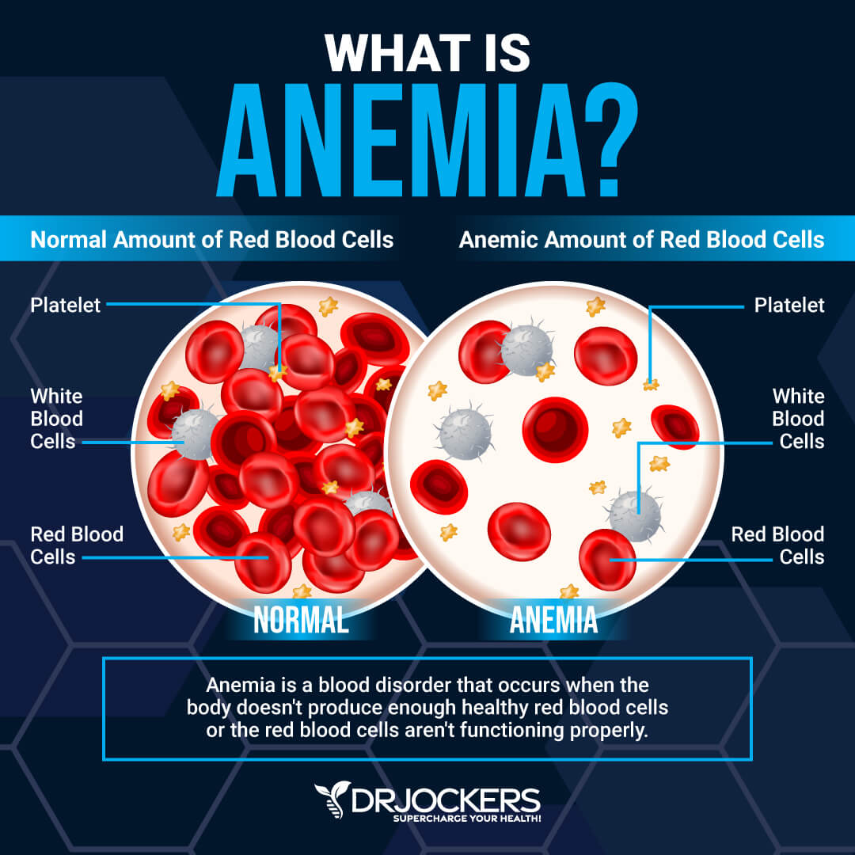
Background
Anemia is a health condition that occurs when there is a deficiency of healthy red blood cells (RBCs) or hemoglobin.
This results in poor oxygen transport for anemic individuals which contributes to symptoms such as:
fatigue
weakness
impaired cognition
Iron supplementation, such as FeSO4 and MNP (Multiple Micronutrient Powders), are recommended to increase iron levels.

Slide 3
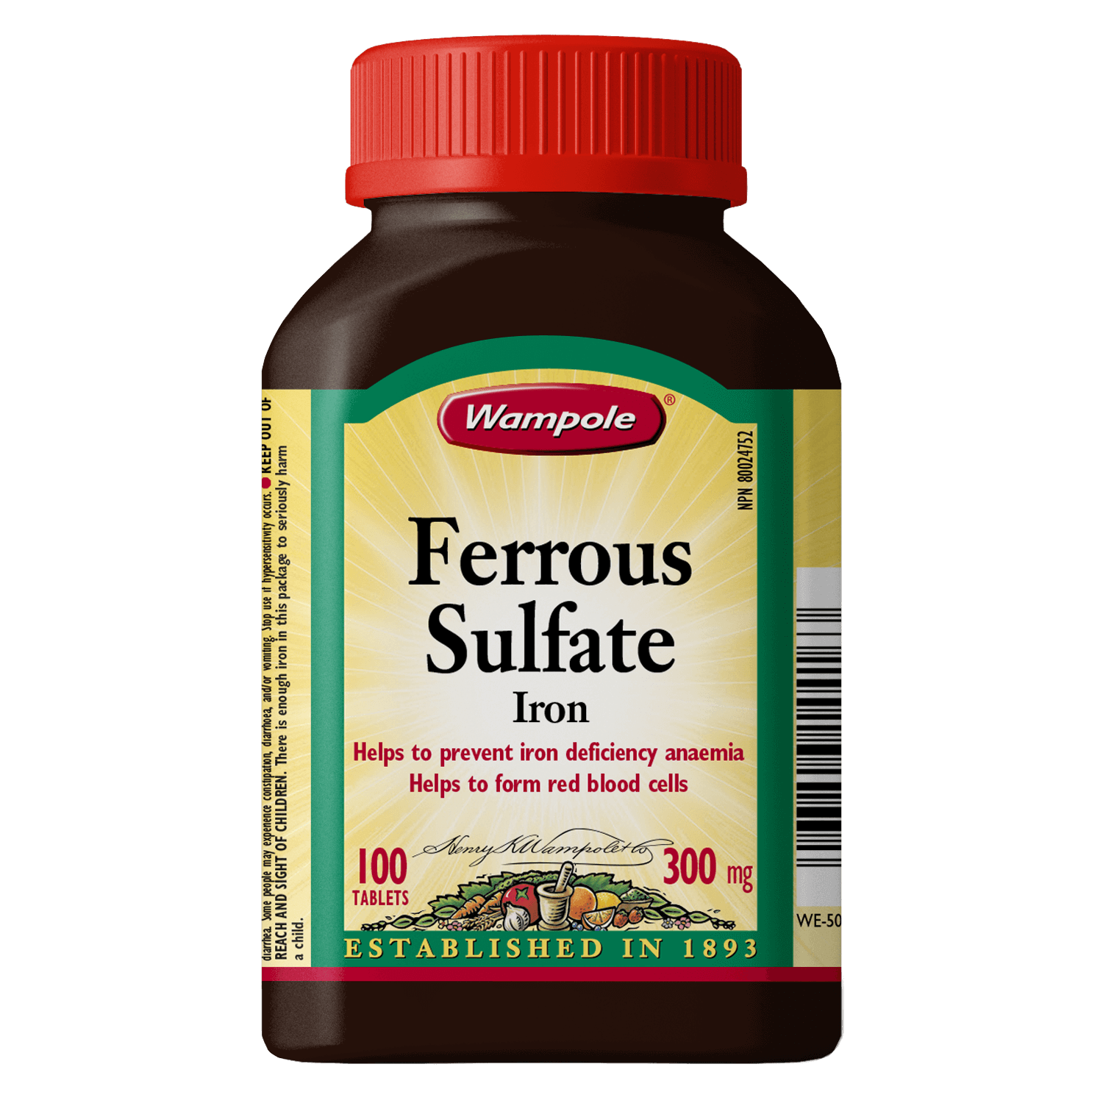
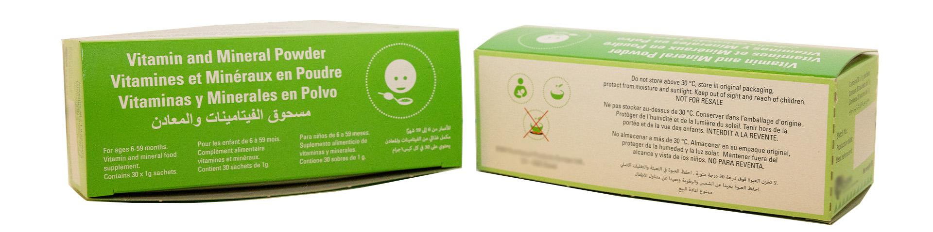
Background
Previous research: No difference in the microbial diversity between anemic and healthy infants, but taking iron supplementation is known to alter the infant microbial composition (reduces Bifidobacteria and Lactobacilli which are beneficial bacteria).
Knowledge gap: FeSO4 and MNP are both common supplements for treating anemia, but their effects on microbial composition relative to each other is still unknown. This is especially important because FeSO4 can often cause side effects like nausea and fever due to its higher iron dosage compared to MNP.

Slide 4
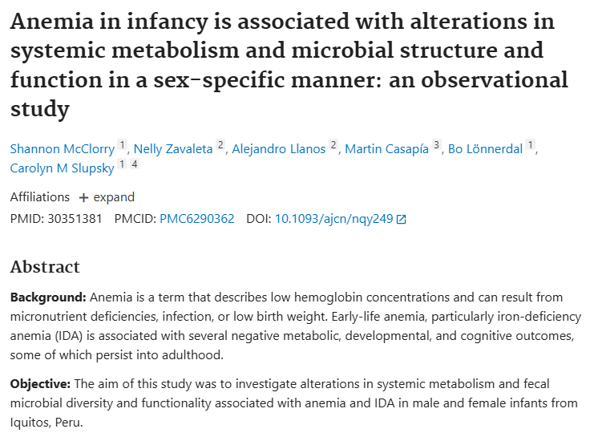
Background
Research question: Among 12 month old anemic infants, how is iron supplementation type (MNP vs. FeSO4 vs. none) associated with gut microbiome composition and function, and how are these microbial differences associated with hemoglobin and ferritin levels?
Using 16s rRNA sequencing data from McClorry et al. (2018)
Samples collected in Iquitos, Peru
102 samples from 12-13 month old healthy/anemic infants on MNP, FeSO₄, or no supplements
Blood samples collected to measure hemoglobin and ferritin levels

Slide 5
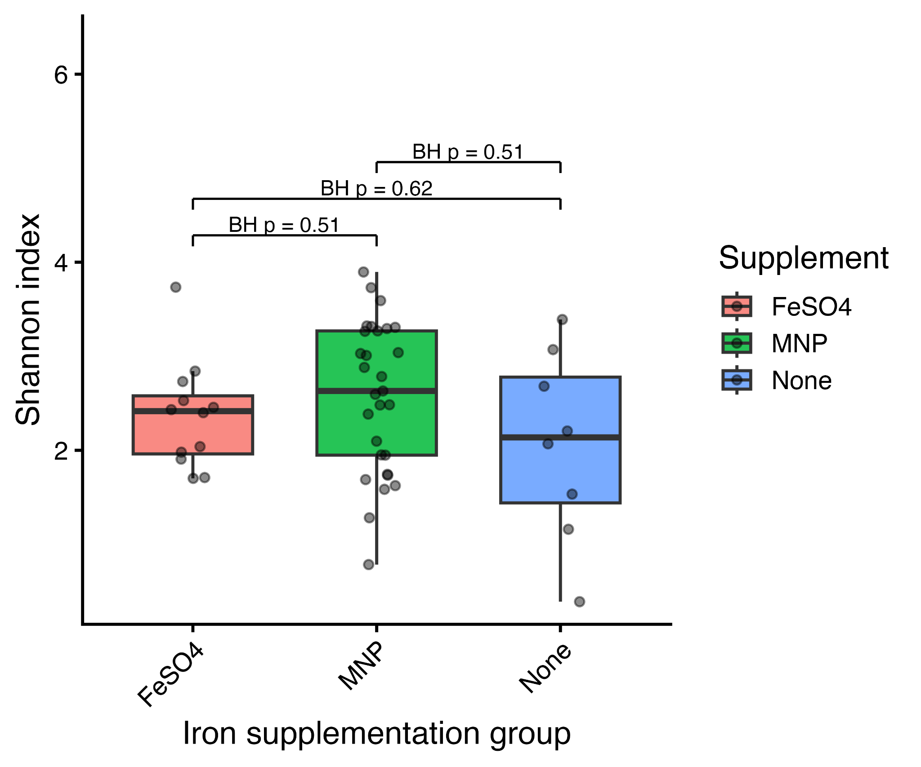
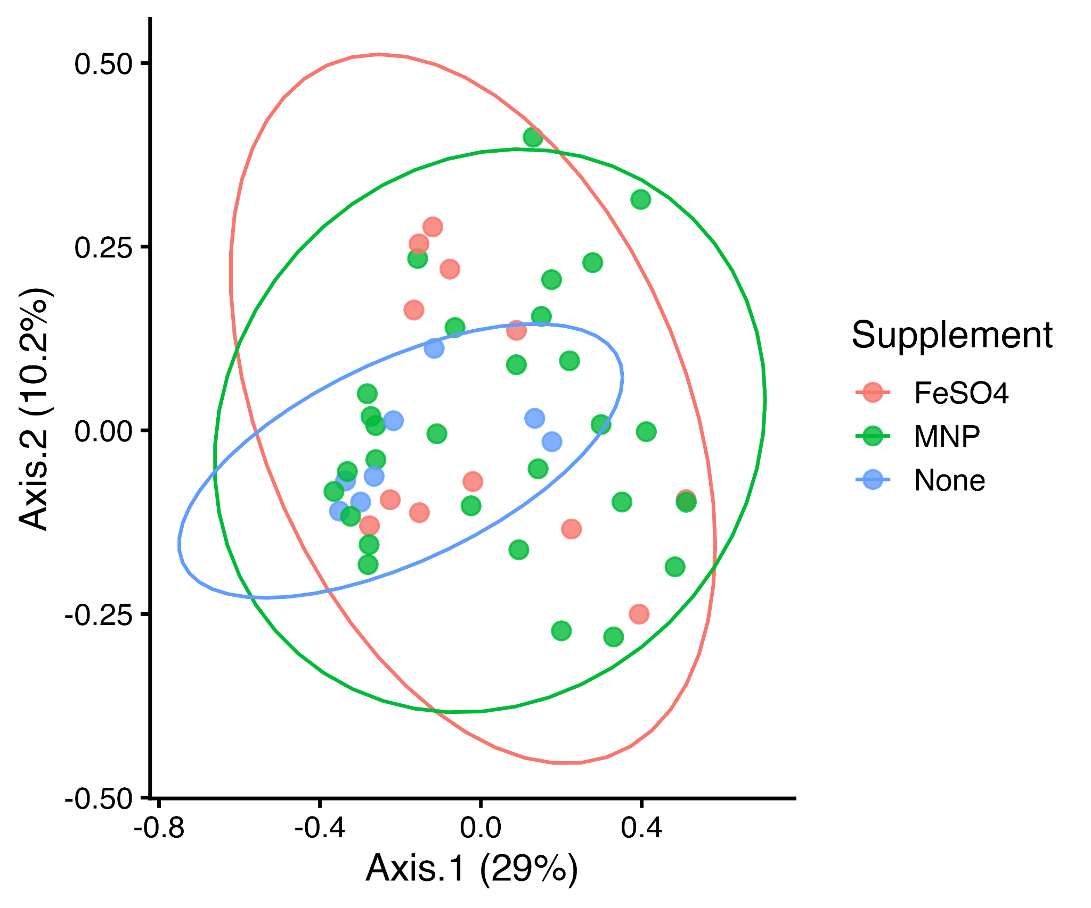
Aim 1: No significant differences in microbiome diversity across supplementation groups
No significant differences in Shannon diversity (BH-adjusted p > 0.05)
Consistent null results across all diversity metrics
No clustering observed beta diversity (Bray / UniFrac)
Microbiome remains stable across supplementation groups

Slide 6
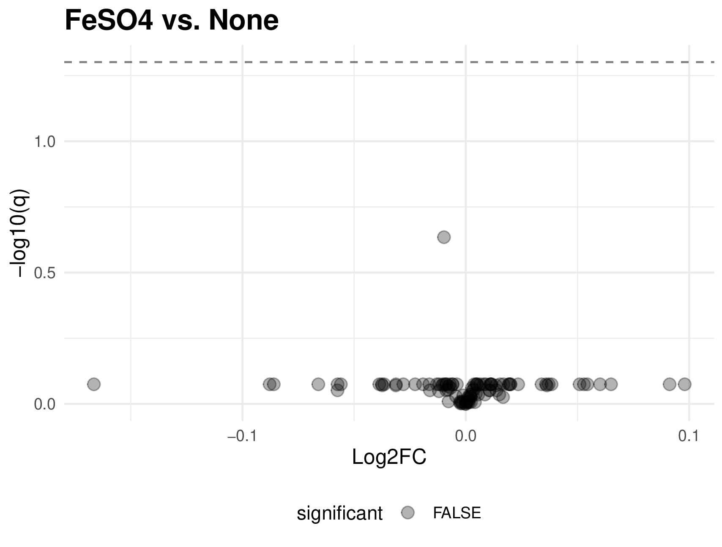
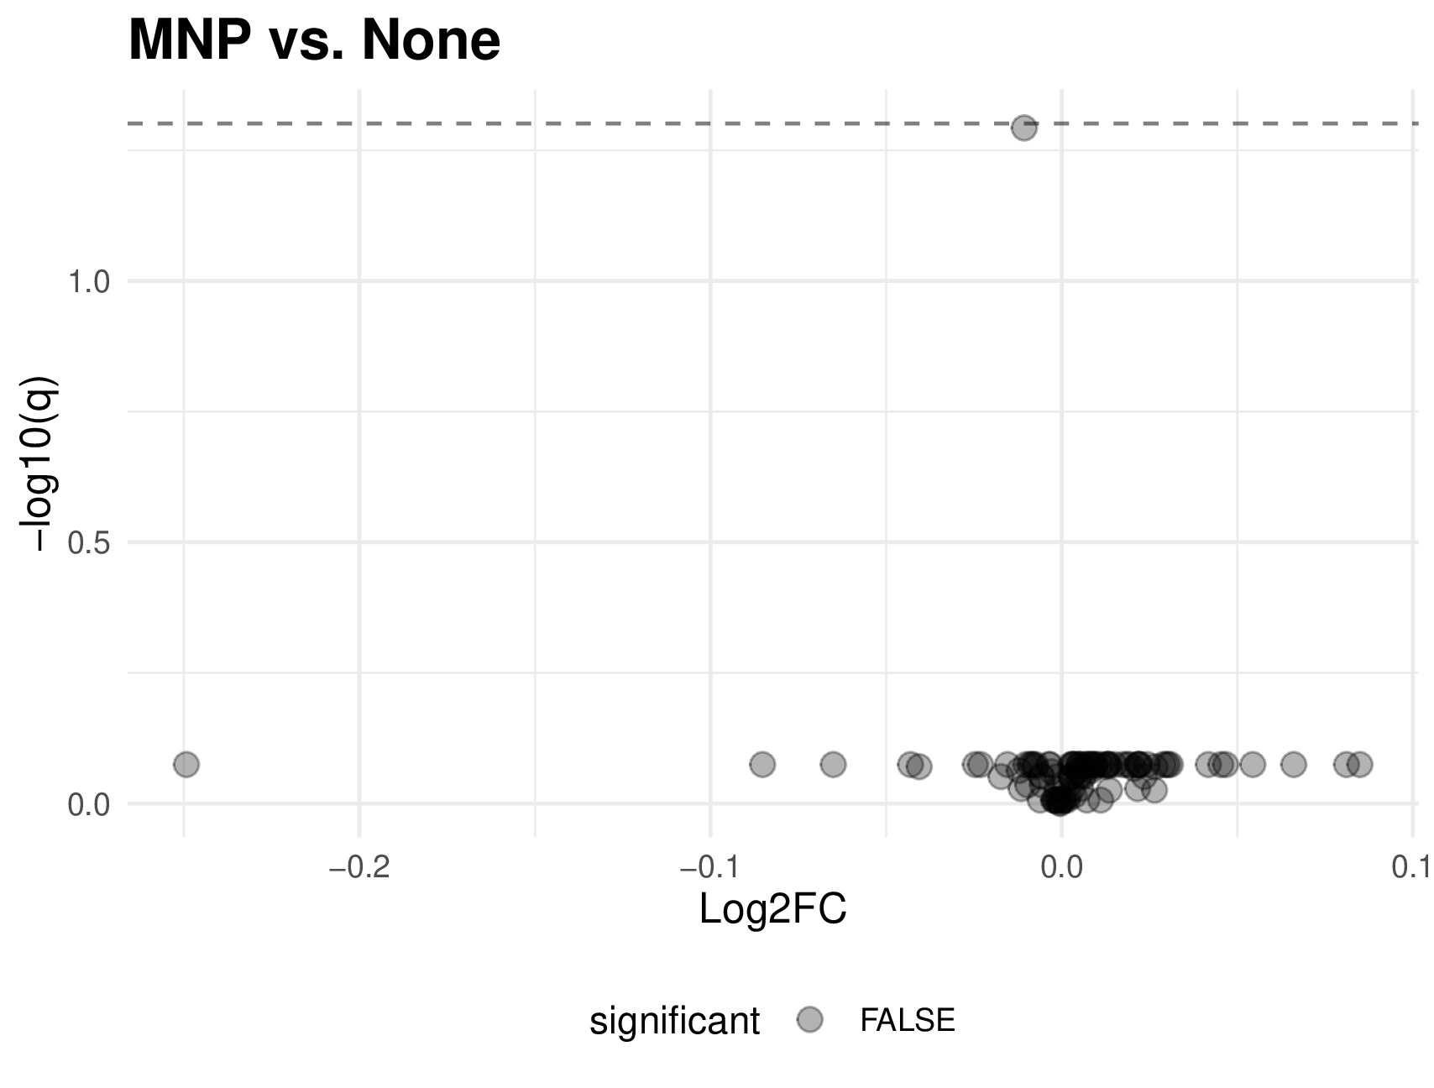
Aim 2: The microbiome does not significantly differ between the treatment groups and the control
Indicator species analysis found no significant taxa that were associated with any supplementation group
No significant difference found in the differential abundance between treated and untreated anemic infants
Volcano plot was used to assess the differences in differential abundance
No taxa-level microbiome shifts detected
A
B

Slide 7
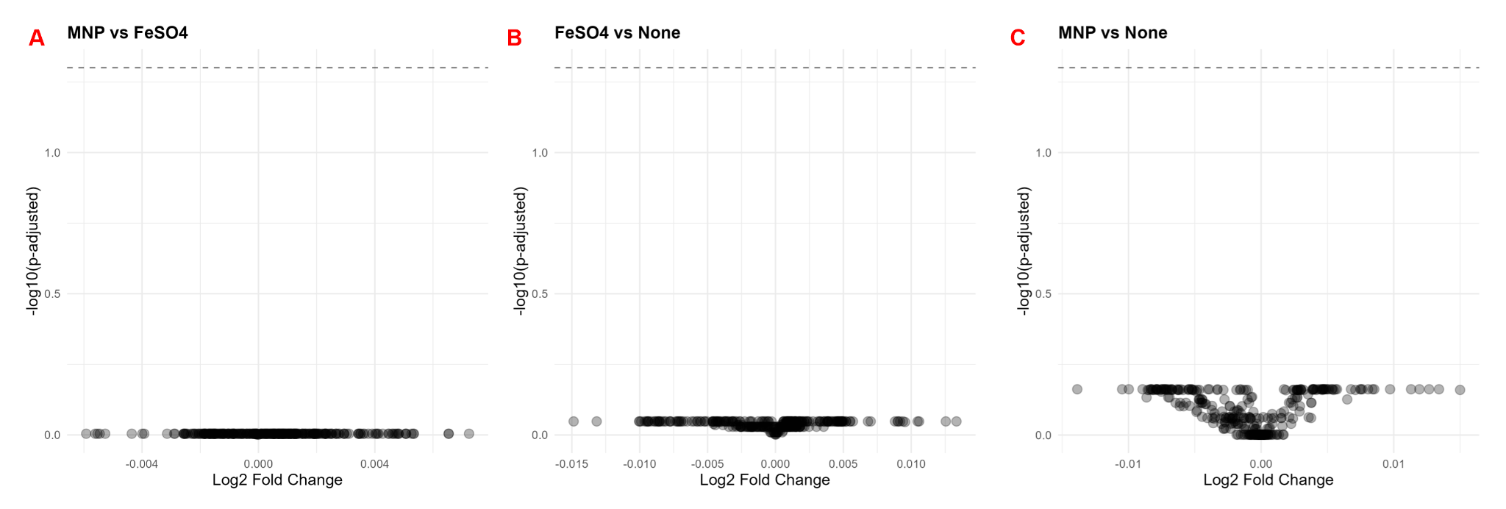
Aim 3: Supplement groups have no significant differences in predicted metabolic composition of the gut microbiome
Threshold of significance (p-adjusted <0.05)
Plot reveals no significant differences in predicted pathway abundance
Points > 0 indicate increased abundance in a treatment group
Notes:
Do the gut microbiomes of different treatment group possess different metabolic pathways?
Methods:
Investigating predicted metabolic pathways using MetaCyc data from PICRUSt2 analysis
Maaslin2 tool to investigate significance of differences in pathway abundance between treatment groups
p-adjusted value of 0.05
Results:
No significant differences in predicted metabolic pathways between supplement groups
Biological significance:
Anemic individuals should expect no gut microbiome metabolic differences regardless of the supplement they are taking
Supplementation likely does not lead to dysbiosis of the gut microbiome

Slide 8
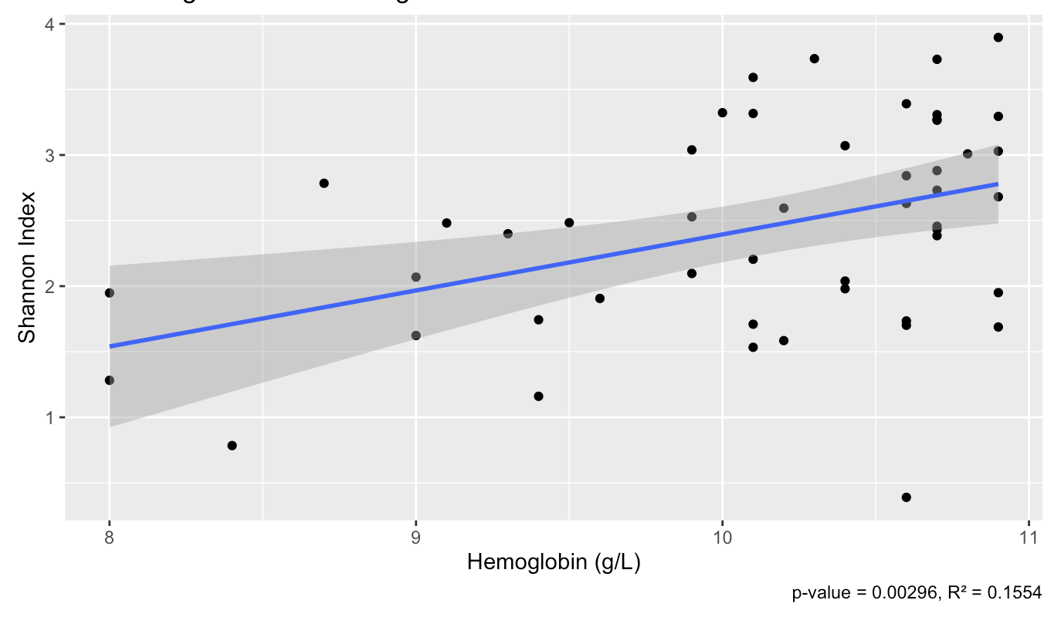
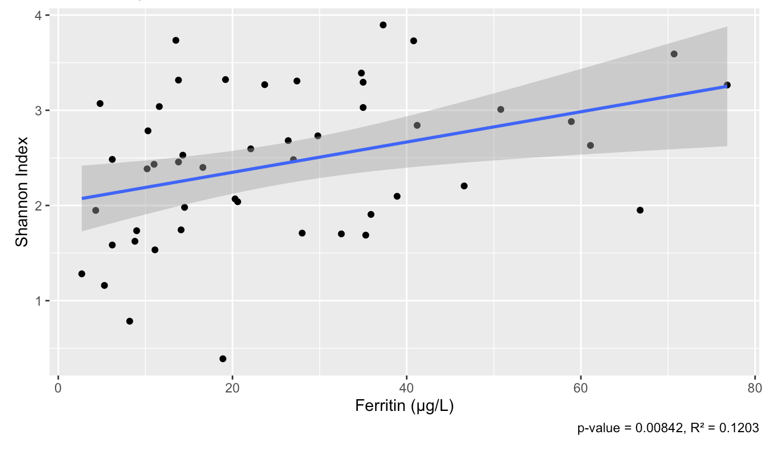
Aim 4: Significant correlations between microbiome diversity and hemoglobin or ferritin levels.
Note: both regression lines do not fit the data well (low R^2 values close to 0)
The positive correlation between the Shannon index and hemoglobin and ferritin levels is significant (p < 0.05)

Slide 9
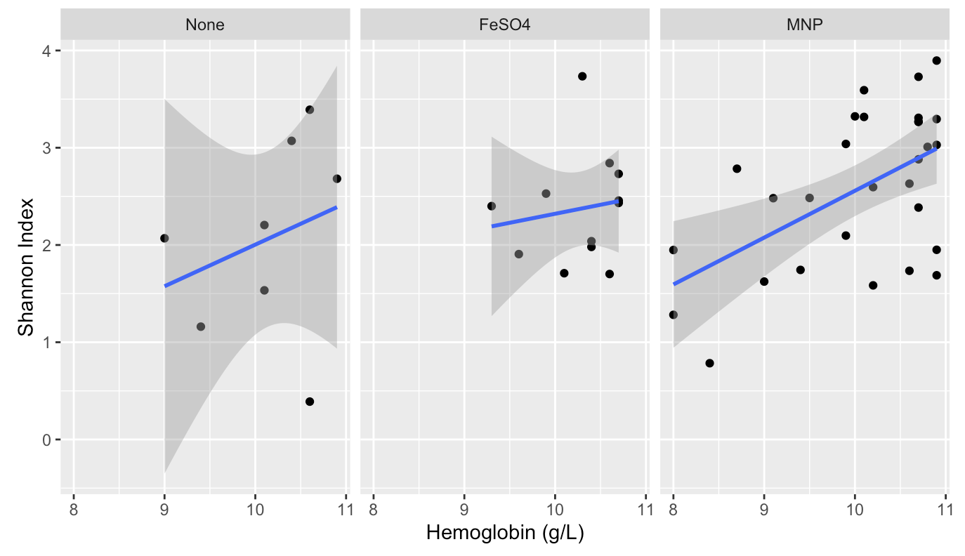
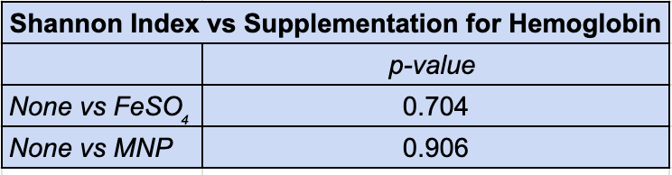
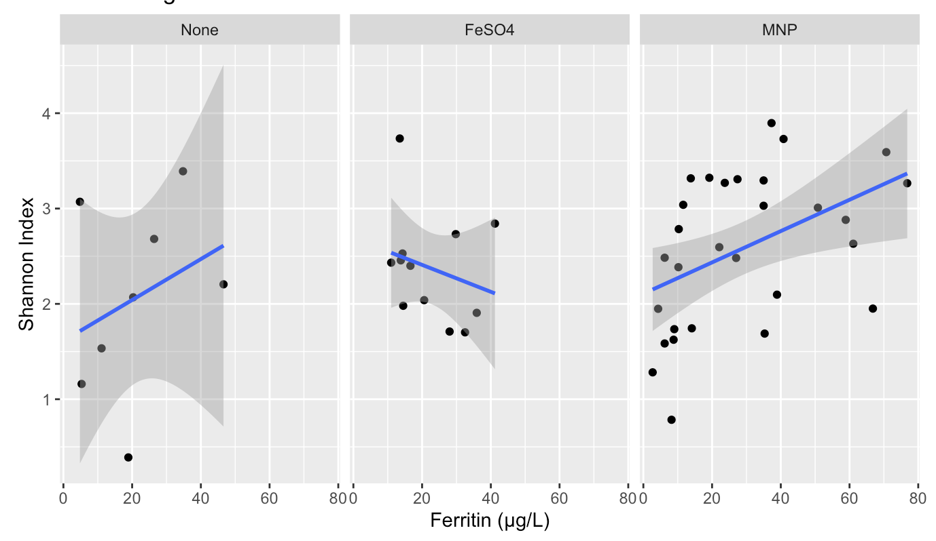
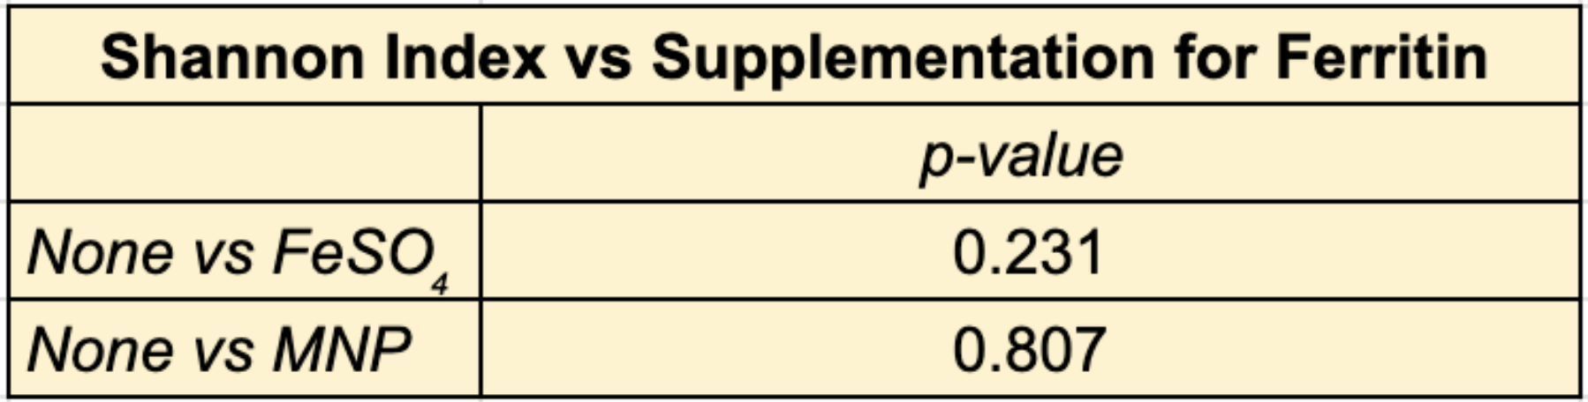
Aim 4: No significant correlation between microbiome diversity and hemoglobin or ferritin levels between supplementation types when compared to non-supplemented infants.
No significant difference between Shannon Index and supplement types when compared to the None (control) group as all p-values > 0.05

Slide 10
What do these results mean for anemic infants?
The gut microbiome does not differ greatly between anemic infants who are taking different kinds of supplements.
The gut microbiome does not differ greatly between anemic infants who are taking different kinds of supplements.
The findings support the conclusion that the metabolic functions of the gut microbiome does not differ between supplement types in anemic infants.
Taking supplements is beneficial for anemic infants because increased hemoglobin or ferritin levels is associated with gut microbial diversity.
This result is good because that means patients can choose to take either FeSO4 or MNP without significantly affecting their microbiome diversity.

Slide 11
What do these results mean for anemic infants?
The gut microbiome does not differ greatly between anemic infants who are taking different kinds of supplements.
The findings support the conclusion that the metabolic functions of the gut microbiome does not differ between supplement types in anemic infants.
Taking supplements is beneficial for anemic infants because increased hemoglobin or ferritin levels is associated with gut microbial diversity.
This result is good because that means patients can choose to take either FeSO4 or MNP without significantly affecting their microbiome diversity.

Slide 12
What do these results mean for anemic infants?
The gut microbiome does not differ greatly between anemic infants who are taking different kinds of supplements.
The findings support the conclusion that the metabolic functions of the gut microbiome does not differ between supplement types in anemic infants.
Taking supplements is beneficial for anemic infants because increased hemoglobin or ferritin levels is associated with gut microbial diversity.
This result is good because that means patients can choose to take either FeSO4 or MNP without significantly affecting their microbiome diversity.

Slide 13
What do these results mean for anemic infants?
The gut microbiome does not differ greatly between anemic infants who are taking different kinds of supplements.
The findings support the conclusion that the metabolic functions of the gut microbiome does not differ between supplement types in anemic infants.
Taking supplements is beneficial for anemic infants because increased hemoglobin or ferritin levels is associated with gut microbial diversity.
This result is good because that means patients can choose to take either FeSO4 or MNP without significantly affecting their microbiome diversity.

Slide 14
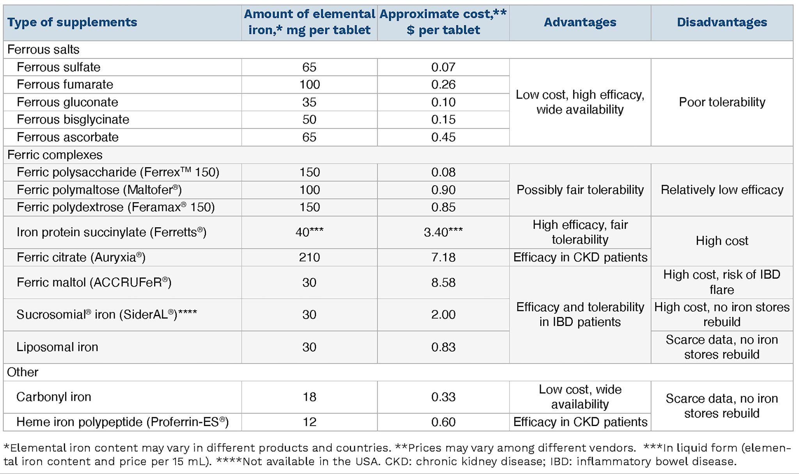
Future directions
Different iron supplementation types?
Anemic infants with infections/diseases
Look at the effects of non-iron supplements like vitamin b12, vitamin b9, or certain minerals like copper
DNA based analysis lacks transcriptional/translational regulatory analysis
Protein/mRNA level analysis in order to confirm functional analysis results
Metatranscriptomics/proteomics
Different iron supplementation types?
Iron Supplement Types

Slide 15
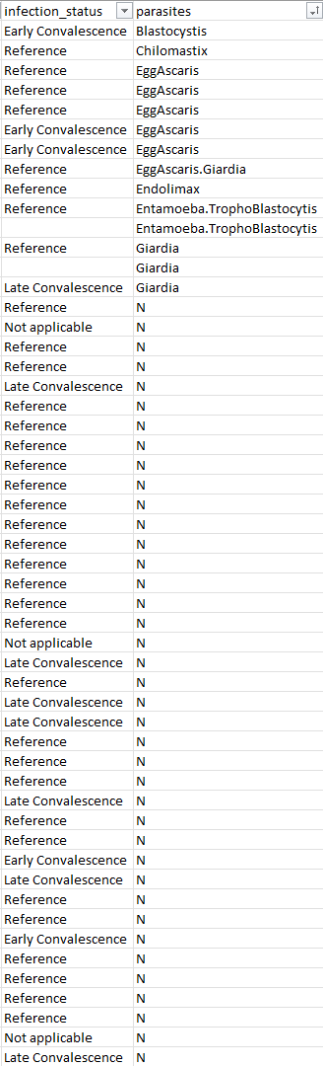
Future directions
Anemia metadata
Different iron supplementation types?
Anemic infants with infections/diseases
Look at the effects of non-iron supplements like vitamin b12, vitamin b9, or certain minerals like copper
DNA based analysis lacks transcriptional/translational regulatory analysis
Protein/mRNA level analysis in order to confirm functional analysis results
Metatranscriptomics/proteomics
Different iron supplementation types?
Anemic infants with infections/diseases

Slide 16
Future directions
Different iron supplementation types?
Anemic infants with infections/diseases
Look at the effects of non-iron supplements like vitamin b12, vitamin b9, or certain minerals like copper
DNA based analysis lacks transcriptional/translational regulatory analysis
Protein/mRNA level analysis in order to confirm functional analysis results
Metatranscriptomics/proteomics
Different iron supplementation types?
Anemic infants with infections/diseases
Look at the effects of non-iron supplements like vitamin b12, vitamin b9, or certain minerals like copper

Slide 17
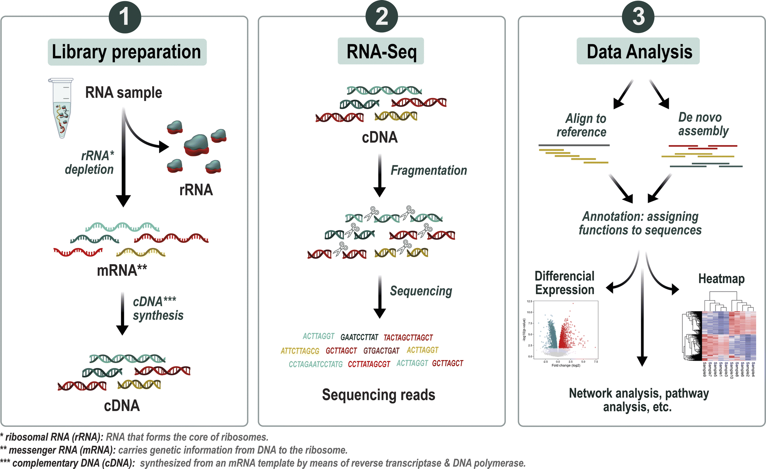
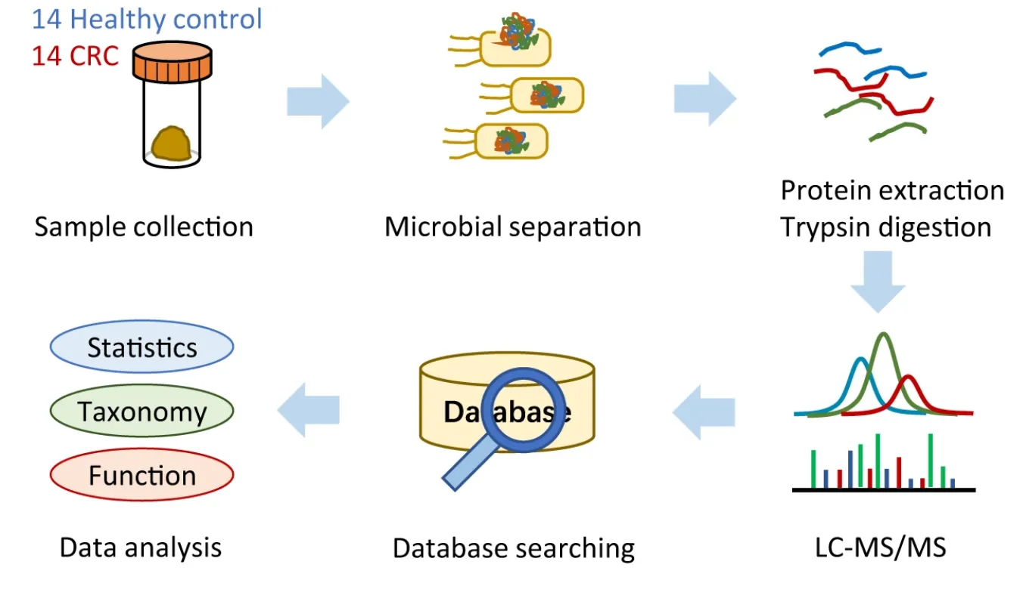
Future directions
Transcriptomics
Proteomics
Different iron supplementation types?
Anemic infants with infections/diseases
Look at the effects of non-iron supplements like vitamin b12, vitamin b9, or certain minerals like copper
DNA based analysis lacks transcriptional/translational regulatory analysis
Protein/mRNA level analysis in order to confirm functional analysis results
Metatranscriptomics/proteomics
Different iron supplementation types?
Anemic infants with infections/diseases
Look at the effects of non-iron supplements like vitamin b12, vitamin b9, or certain minerals like copper
DNA based analysis lacks transcriptional/translational regulatory analysis
Protein/mRNA level analysis in order to confirm functional analysis results
Metatranscriptomics/proteomics

